Slide 1

Online Test Management Tool

Slide 2
Objective:
Online test will reduce the hectic job of correcting the answers manually.
It will reduce the usage of paper.
The result of the exam will be immediately displayed to students.
It helps educational institutions to conduct test and analyze their performance.

Slide 3
Institution Aspect:
Registering institution details.
Logging into the system.
Updating student database based on their requirements.
Uploading Questions and keys for exams.
Giving time constrains and marks for exam.
Viewing the student records and analyzing their performance.

Slide 4
Student Aspect:
Logging into system.
Selecting a test.
Finishing the test within time.
Viewing their report.
Analyzing their performance based on previous tests.

Slide 5

Output Screen Shot:
Home page:

Slide 6
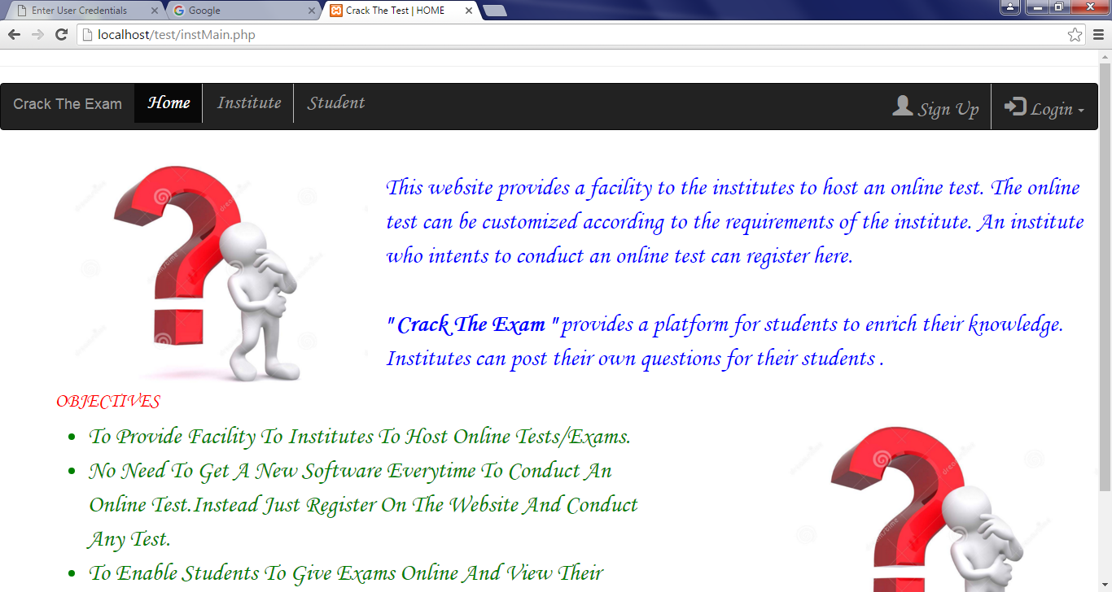
Institution home page:

Slide 7
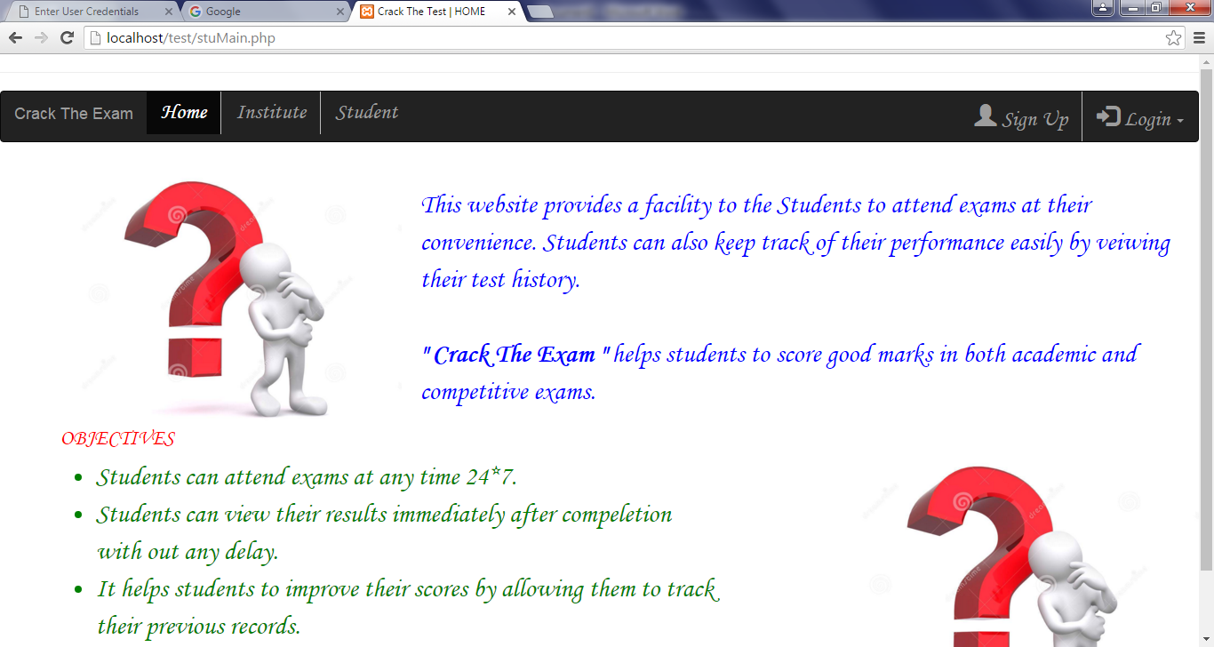
Student home page:

Slide 8
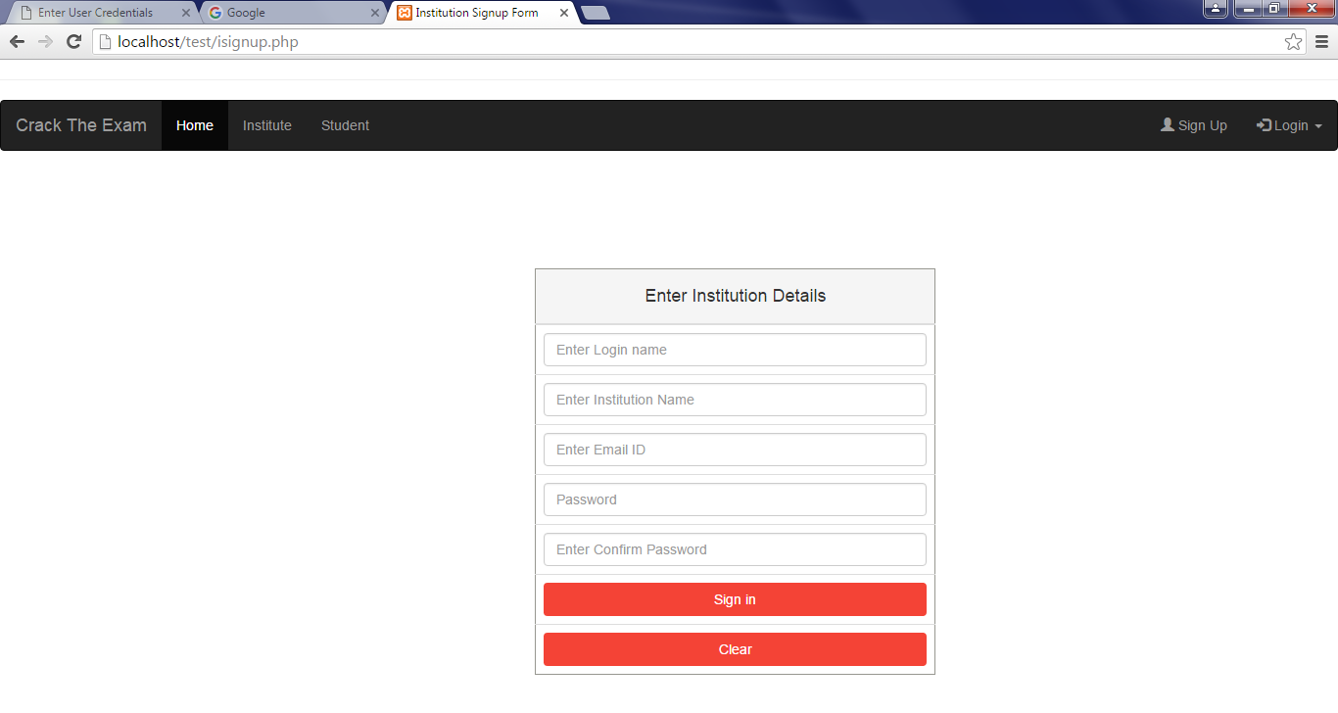
Institution Signup form:

Slide 9
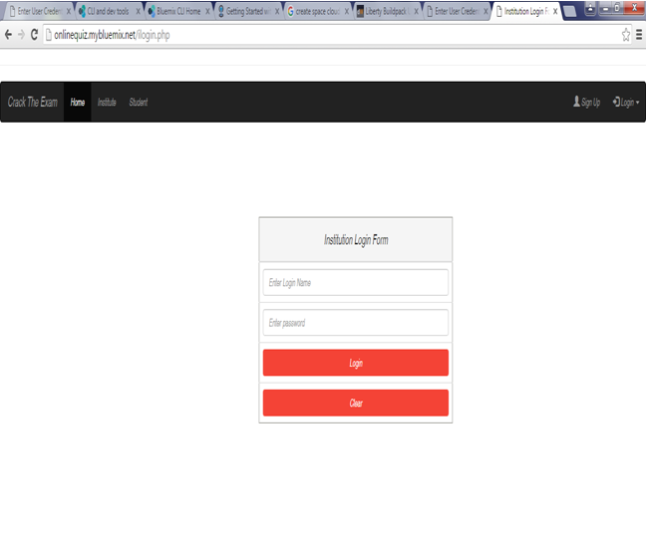
Institution Login page:

Slide 10
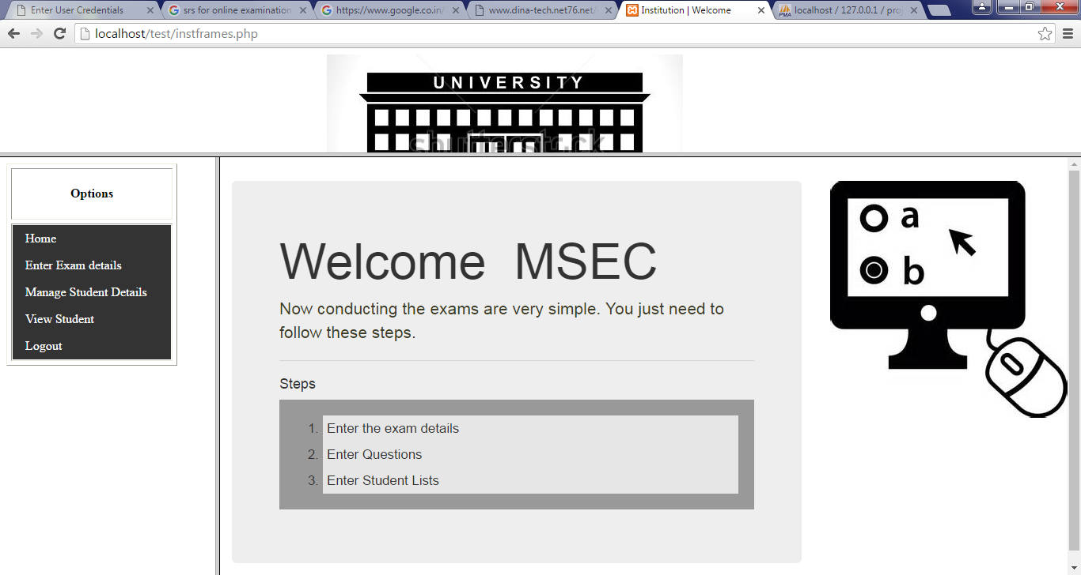
Institution welcome page:

Slide 11
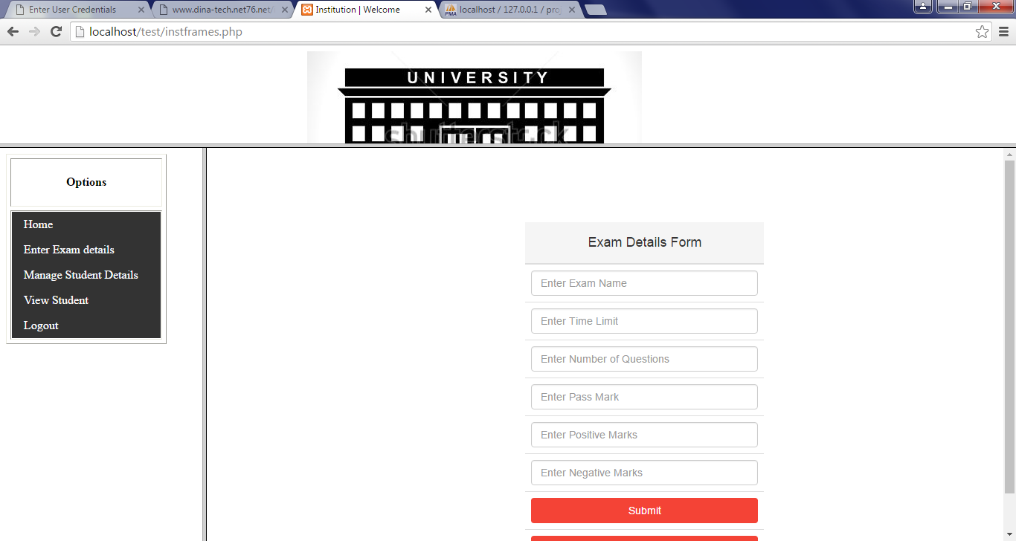
Exam details form:

Slide 12
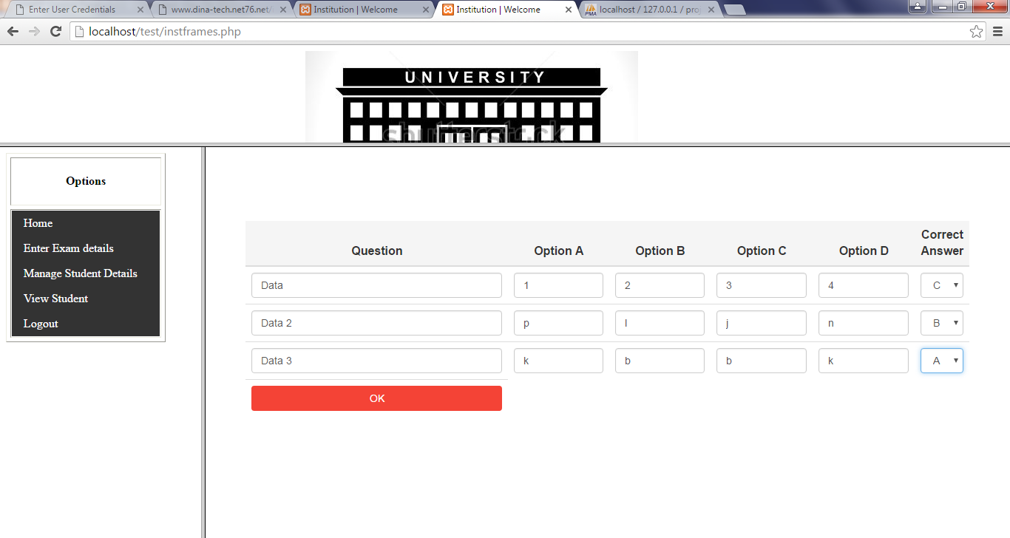
Uploading Question and key:

Slide 13
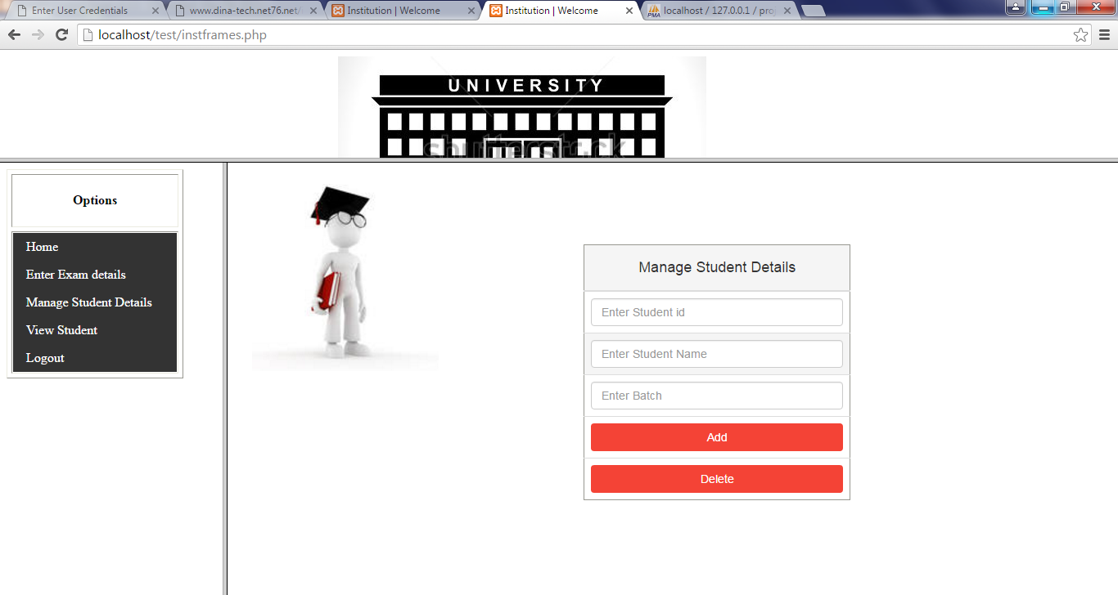
Updating student database:

Slide 14
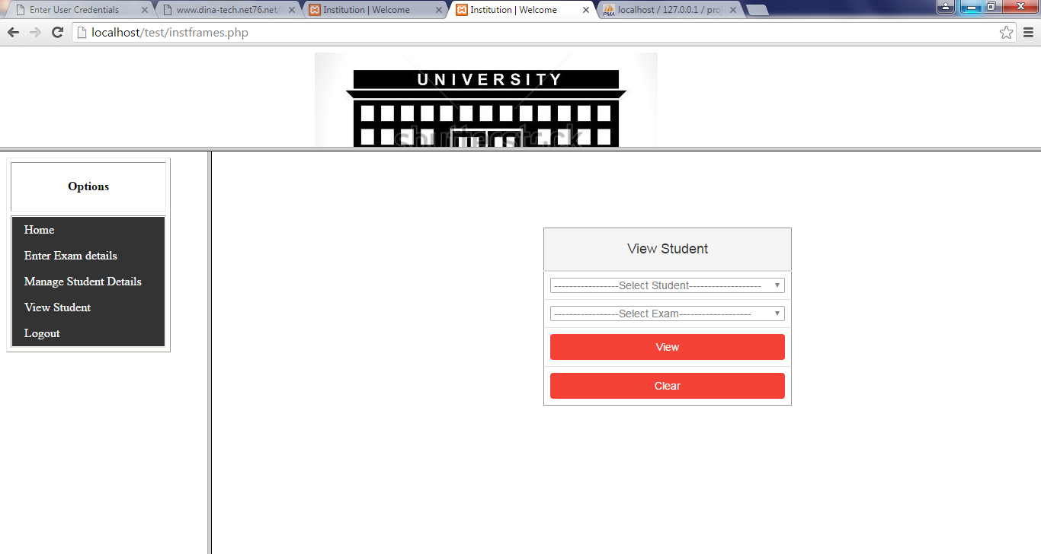
View student records:

Slide 15
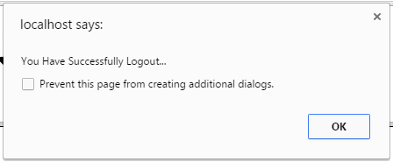
Institution Logout:

Slide 16
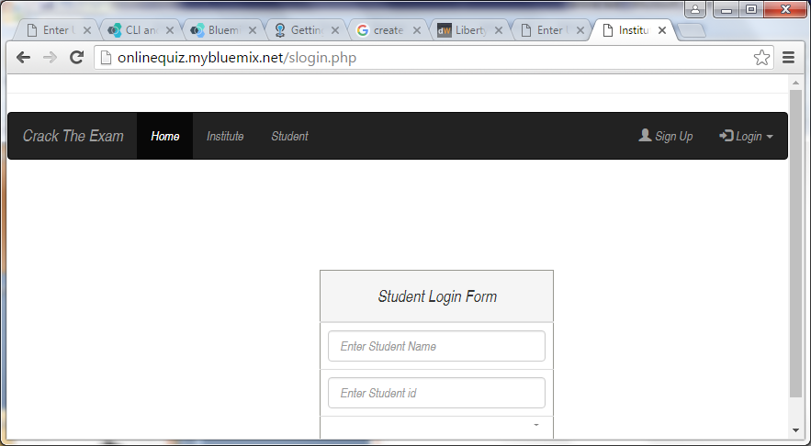
Student Login page:

Slide 17
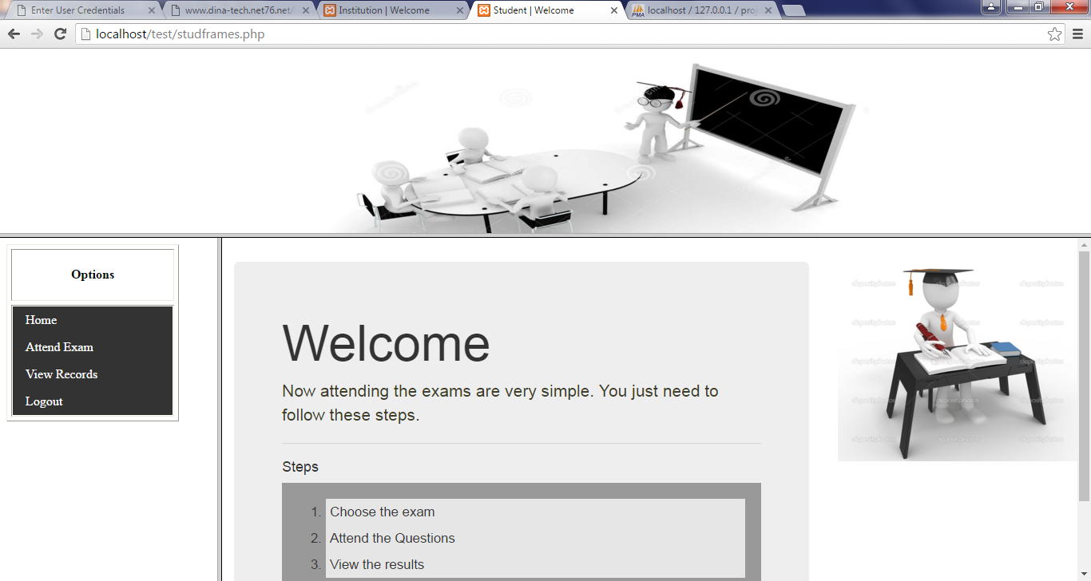
Student welcome page:

Slide 18
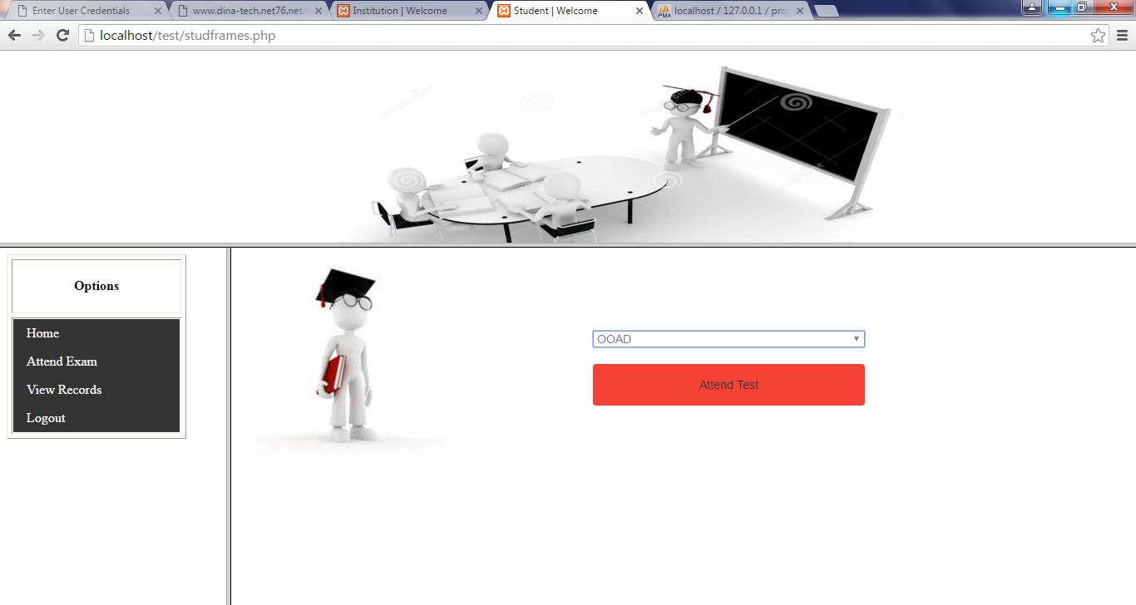
Choose Exam:

Slide 19
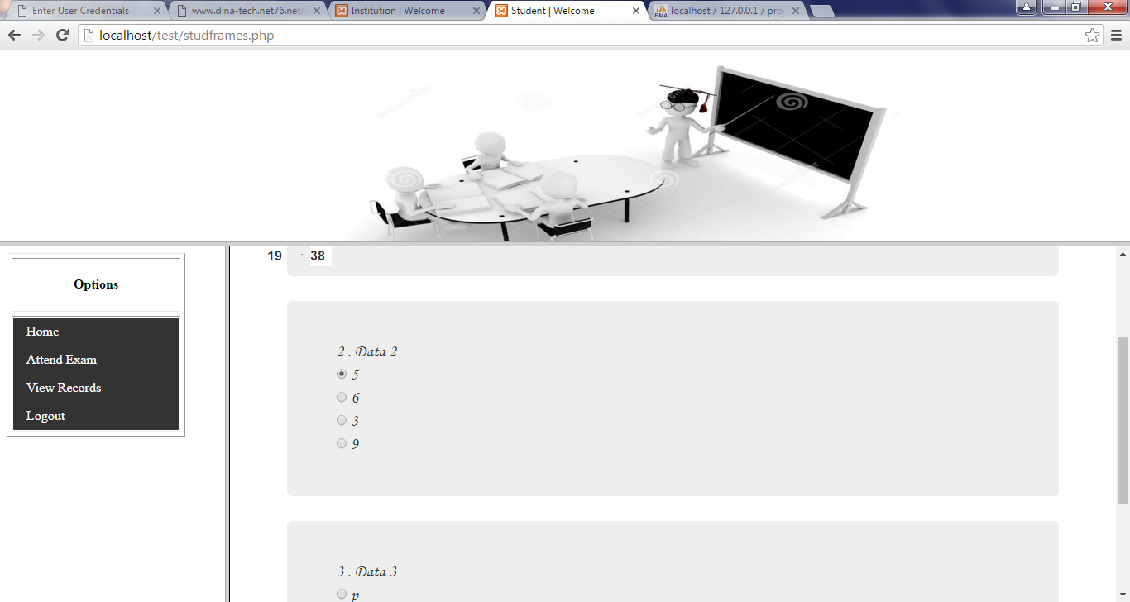
Exam page:

Slide 20
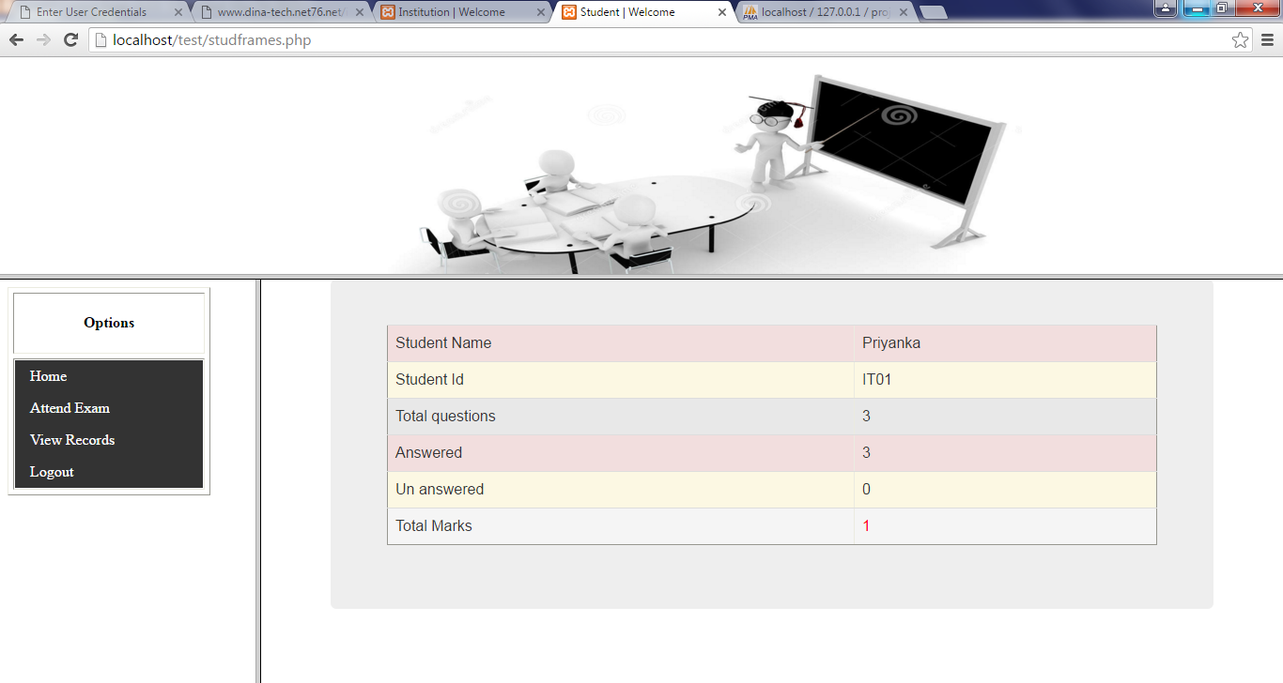
View Report:

Slide 21
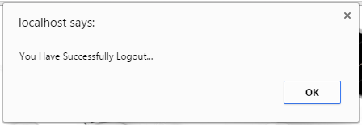
Student Logout:

Slide 22
Conclusion:
This tool helps all the interested institutions to conduct exams in a effective manner.
It reduces manual works like correcting papers and manipulation of result.
It is eco friendly.
It provides good user interface.

